Slide 1
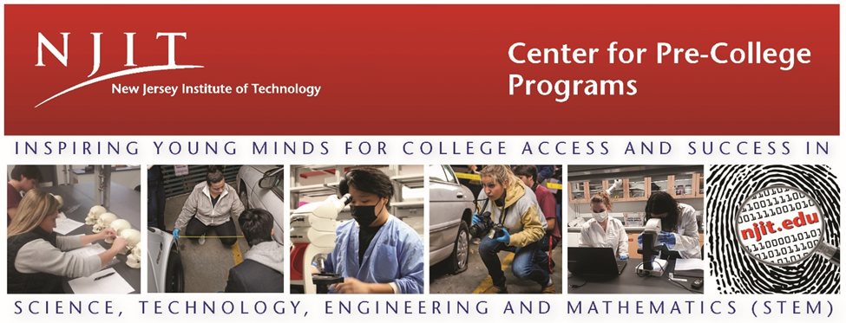
New Jersey Forensic Science Education Conference
June 24-26, 2024
NJIT Campus
Newark, NJ

Slide 2
New Jersey Forensic Science Education Conference
2
Conference Agenda
Day 1 – CSI
Monday, June 24
8:00 a.m. – 8:30 a.m. Registration & Breakfast
Eberhardt Hall 112
8:30 a.m. – 8:50 a.m. Opening Remarks
Dr. Teik Lim, NJIT President
Dr. Jacqueline L. Cusack, Executive Director, NJIT Center for Pre-College Programs
Prof. David Fisher, Director, NJIT Forensic Science
9:00 a.m. – 10:30 a.m. Processing a Crime Scene - Group A - Crime Scene Apartment - PC Mall Room 41
Group B - Crime Scene Cars - Summit Deck Lower Level
FBI Evidence Response Team
10:30 a.m. – 10:40 a.m. Hydration Break - by Crime Scene Apartment PC Mall - Room 47
10:40 a.m. – 11:50 a.m. Processing a Crime Scene - Group A - Crime Scene Cars - Summit Deck Lower Level
Group B - Crime Scene Apartment - PC Mall Room 41
FBI Evidence Response Team
noon – 1:15 p.m. Lunch
Dr. Laurent Simon, NJIT Vice Provost for Undergraduate Studies
Keynote: Sarah Chu, PhD
Perlmutter Center for Legal Studies, Cordoza Law School
Eberhardt Hall 112
1:30 p.m. – 3:00 p.m. Virtual Crime Scenes
Dr. Kevin Parmelee, Joel Almoradie GITC 1402 - XR Lab
Day 2 – Forensic Biology
Tuesday, June 25
8:00 a.m. – 8:30 a.m. Coffee & Tea
Eberhardt Hall 112
8:30 a.m. – 10:00 a.m. Genetic Genealogy Part I
Dr. Dana Philipps
Eberhardt Hall 112 (bring your laptops)
10:00 a.m. – 10:10 a.m. Hydration Break
10:10 a.m. – 11:50 a.m. Genetic Genealogy Part II
Dr. Dana Philipps
Eberhardt Hall 112 (bring your laptops)
noon – 1:15 p.m. Lunch
Dr. John Pelesko, NJIT Provost
Keynote: Britton Morin, M.S.F.S.,
Lab Director, Union County (NJ) Prosecutor’s Office Forensic Laboratory
Eberhardt Hall 112
1:20 p.m. – 2:05 p.m. Forensic Serology
Prof David Fisher
Tiernan Hall 209
2:10 p.m. – 3:00 p.m. Histopathology
Prof David Fisher
Tiernan Hall 209
Day 3 – Criminalistics
Wednesday, June 26
8:00 a.m. – 8:30 a.m. Coffee & Tea
Tiernan Hall 2nd floor
8:30 a.m. – 10:00 a.m. Investigating the MicroUniverse - Measuring Using the Microscope,
FSI Teachers Tiernan Hall 209
10:00 a.m. – 10:10 a.m. Hydration Break
10:10 a.m. – 11:50 a.m. Shooting Reconstruction,
Dr. Kevin Parmelee Tiernan Hall 209
noon – 1:15 p.m. Lunch
Holly Stern, Esq., NJIT General Counsel and Vice President, Legal Affairs
Keynote: Jennifer Sellitti, J.D., NJ Public Defender
Eberhardt Hall 112
1:15 p.m. – 2:05 p.m. Forensic Document Examination
Mr. John Osborn
Eberhardt Hall 112
2:05 p.m. – 3:00 p.m. Takeaways: How Does What We Learned Work in Middle and High School Classrooms?
An Interactive Discussion with FSI HS Teachers
Eberhardt Hall 112
Before you go, please complete the Conference Evaluation.
Please see the campus map on the next page…

Slide 3
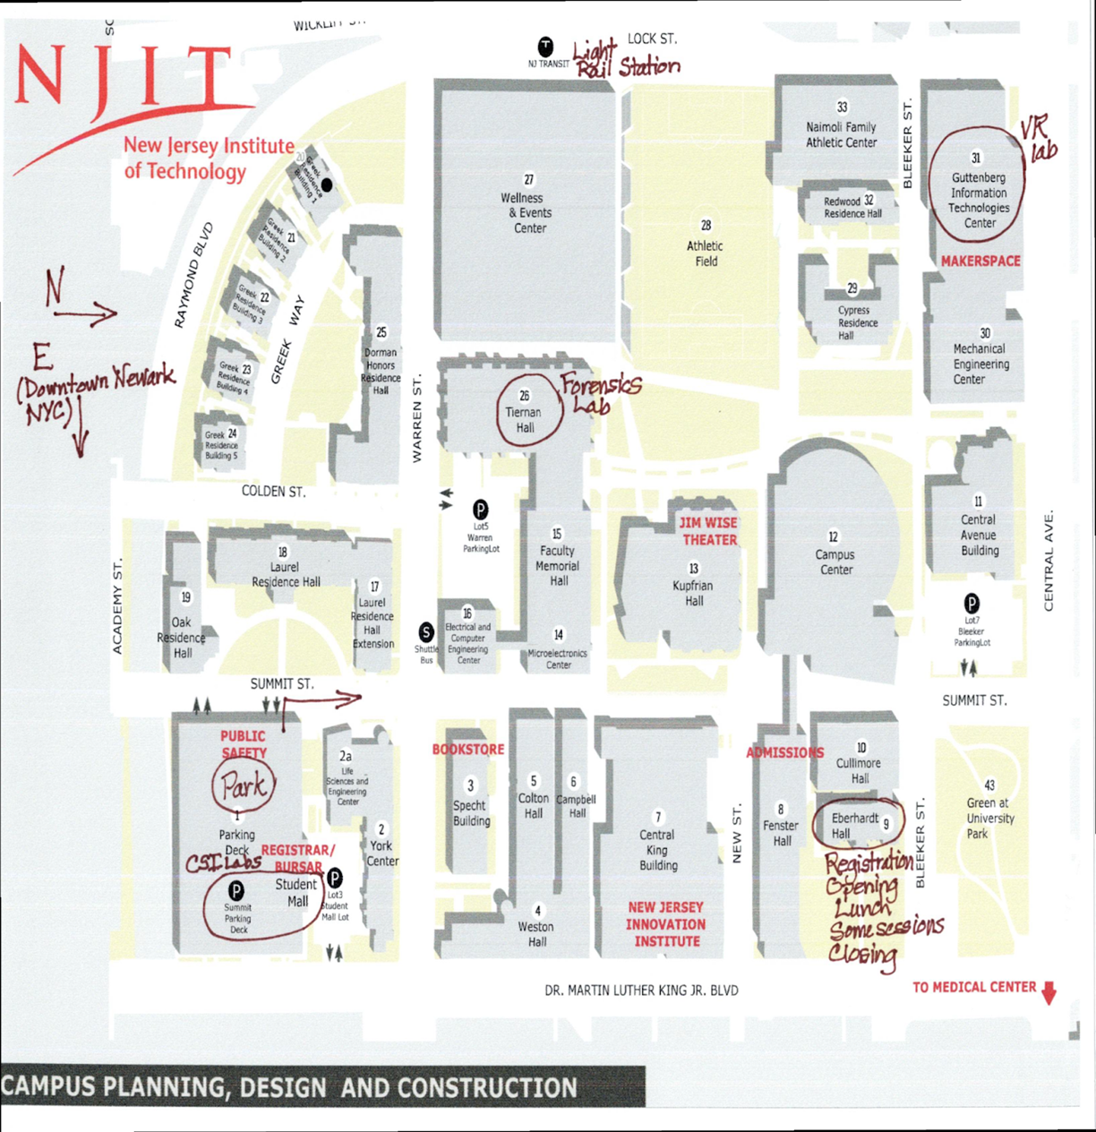
New Jersey Forensic Science Education Conference
3
NJIT Campus
Conference locations highlighted in brown

Slide 4
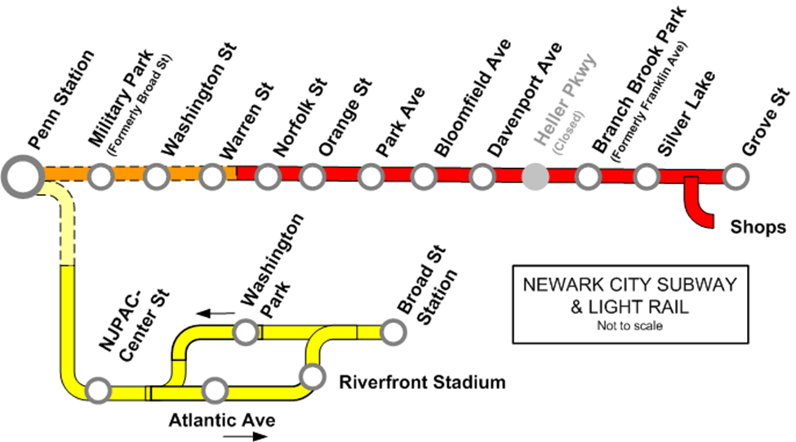
Transportation
4
Parking is reserved for all workshop participants in the Summit Street Deck GPS input: 154 Summit Street, 07103
Exit the deck from the same side you entered - onto Summit Street - and turn right. See the map on the previous page.
If you’re staying in downtown
Newark, the Light Rail/subway
has a stop on campus. It’s also
marked on the campus map on
the previous page.
Suburban trains stop at the Broad
Street Station, which is a 10-min
walk along MLK Boulevard or
University Avenue.
NJIT

Slide 5
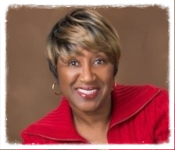
5
Jacqueline L. Cusack, Ed. D.
Executive Director
Center for Pre-College Programs, NJIT​
Jacqueline.l.cusack@njit.edu
Dr. Cusack has served NJIT in various roles since December 2012. Before NJIT, her career was centered in the public school arena where she served in positions ranging from classroom teacher, principal, and curriculum supervisor to acting assistant commissioner of education for the New Jersey Department of Education, assistant superintendent of schools, and superintendent of schools. She also taught educational administration and foundations courses at the undergraduate, masters, and doctoral levels at Teachers College, Columbia University, Virginia Tech, New Jersey City University, and Saint Peter’s University.
Dr. Cusack is the founder of My Sister’s Keeper, Inc., a non-profit organization with the mission of providing mentoring services and scholarships for girls. Established in 1986, My Sister’s Keeper, Inc. also provides emergency financial assistance to families, especially female-headed households. Her state and community activities also include an appointment as a public member of the Supreme Court of New Jersey’s District Ethics Committee, District VA; emeritus trustee for the Columbia High School Scholarship Fund, South Orange and Maplewood School District; and membership in the New Jersey Association of School Administrators.
Dr. Cusack has a B.A. from Elmira College, M.A. and Ed.M. from Teachers College, Columbia University, and Ed.D. from Virginia Tech.

Slide 6
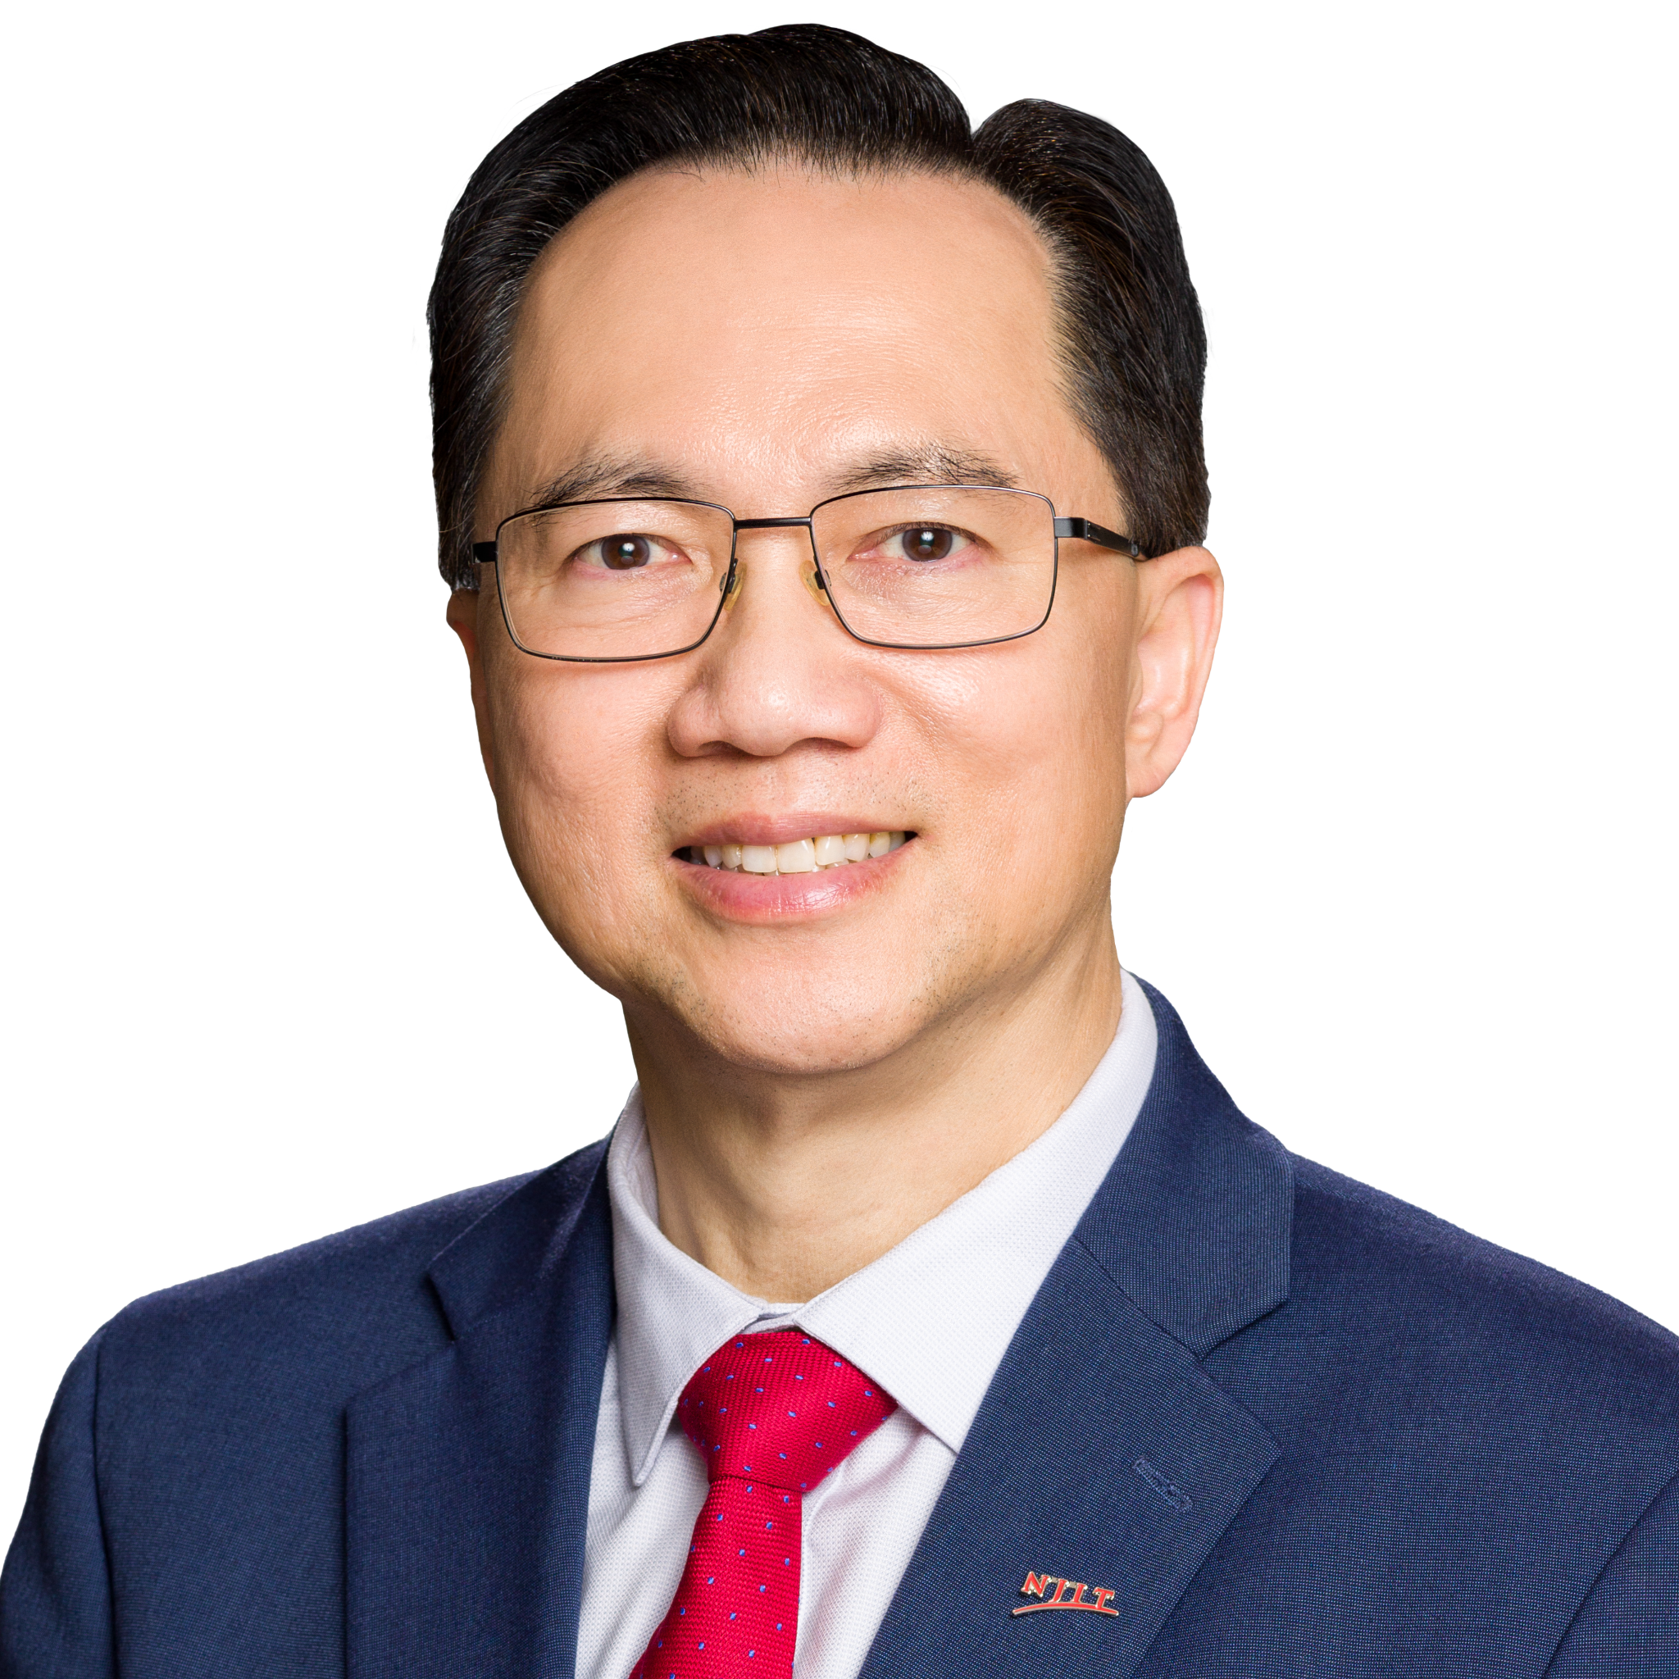
6
Welcome to NJIT
Monday, June 24th
Dr. Teik C. Lim
President, Distinguished Professor of Mechanical Engineering
New Jersey Institute of Technology
Dr. Teik C. Lim is the 9th President of New Jersey Institute of Technology (NJIT) and also holds the title of Distinguished Professor of Mechanical Engineering. Prior to joining NJIT on July 1 of 2022, Dr. Lim led the University of Texas at Arlington (UTA) as interim president from 2020-2022 and was Provost and Vice President for Academic Affairs at UTA from 2017-2020.
Dr. Lim’s career began in the private sector before transitioning to faculty appointments and then to university administration. He worked as an engineer at Structural Dynamics Research Corporation before joining The Ohio State University Center for Automotive Research as a research scientist. He taught at the University of Alabama beginning in 1998, as associate professor, before joining the University of Cincinnati in 2002, where he advanced from associate professor to professor to department head and to
associate dean for graduate studies and research before, ultimately, being named Dean of the College of Engineering and Applied Science.
Dr. Lim earned his Bachelor of Science in Mechanical Engineering (ME) from Michigan Technological University, his Master of Science in ME from the University of Missouri-Rolla, and his Ph.D. in ME from The Ohio State University.
Dr. Lim is internationally recognized as a leading scholar in the field of structural vibrations and acoustics as well as modeling and simulation technology. He was named a Fellow of the National Academy of Inventors in 2018. He is also Fellow of the American Society of Mechanical Engineers and the Society of Automotive Engineers. Dr. Lim was recognized with the Thomas French Alumni Achievement Award in 2010, the GearLab Distinguished Alumnus Award in 2017, and the Distinguished Alumni Award for Academic Excellence in 2019 from his alma mater, The Ohio State University.

Slide 7
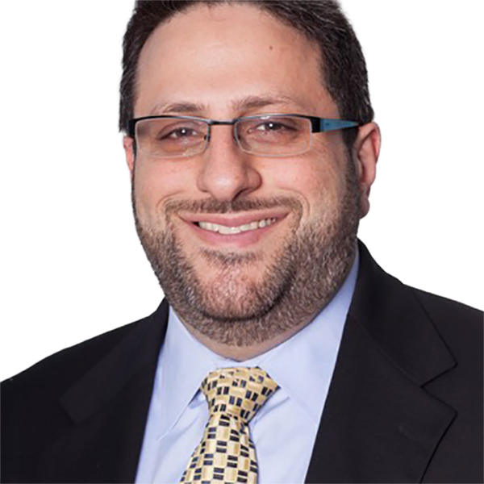
New Jersey Forensic Science Education Conference
7
David Fisher, M.S., ABC-GKE, FAAFS
Director, NJIT Forensic Science Program
Conference Director
Senior University Lecturer, Department of Chemistry and Environmental Science
David.r.fisher@njit.edu
A former Criminalist in the Department of Forensic Biology at the New York City Office of Chief Medical Examiner (OCME), Professor of Practice David Fisher is Director of the Forensic Science Program in the Department of Chemistry and Environmental Science at NJIT. Prior to joining NJIT, he spent seventeen years working criminal cases that included homicides, sexual assaults, and property crime investigations with the New York City Office of Chief Medical Examiner in the department of Forensic Biology.
Professor Fisher also serves in the US Dept of Health and Human Services, Office of the Assistant Secretary for Preparedness and Response, Disaster Mortuary Operational Response Team. He holds an M.S. in Forensic Science from CUNY John Jay College Criminal Justice, and a B.S., from the University of California-San Diego in Biochemistry & Cell Biology.
DATE TIME LOCATION SESSION
Tues, 6.25.2024 1:20-2:05 pm Tiernan Hall 209 Forensic Serology
Tues, 6.25.2024 2:10-3:00 pm Tiernan Hall 209 Histopathology

Slide 8
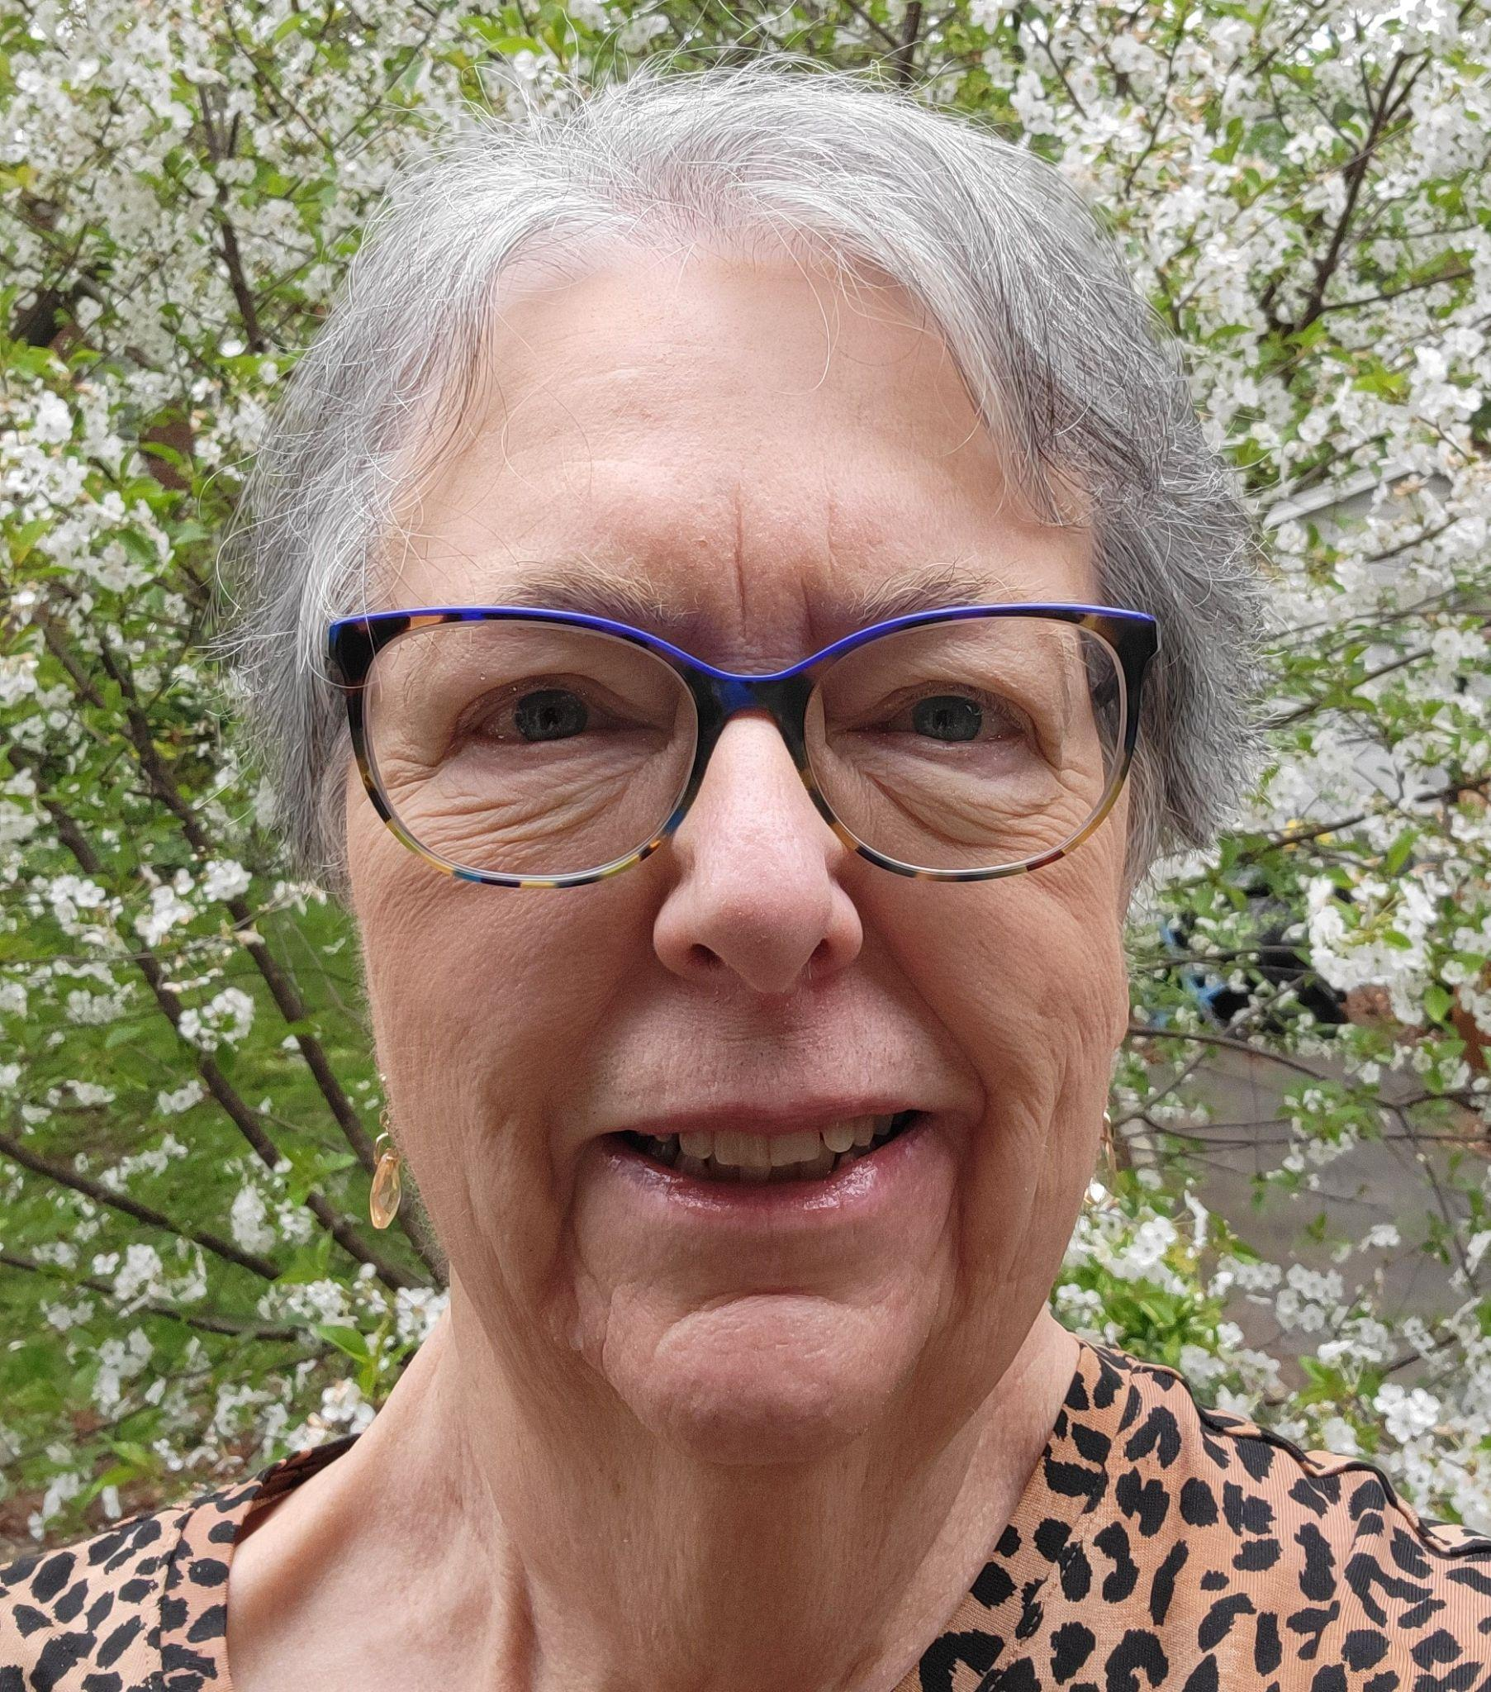
8
Barbara Elder Weller, Ed.D.
Senior Director of Program Development and Forensic Science Initiative
NJIT Center for Pre-College Programs
Conference Coordinator
weller@njit.edu 973-596-5492
Dr. Weller has more than 40 years experience in public education. She has worked with students, teachers, parents, and school administrators to conceptualize, write, and implement curriculum and pedagogy across disciplines in order to maximize learning. Her professional passion is creating dynamic educational environments for all learners, emphasizing learning as a life-long pursuit. She has also published and presented extensively on a variety of educational topics.
In addition to extensive teaching and supervisory experience from first grade through college, Dr. Weller had the privilege of working with a team of teachers and parents to create a new public elementary school in which she later taught and then was the principal. She also moved the school to a new, purpose-built LEED facility, doubling its student capacity, and implementing structured, research-based programs to raise student and teacher achievement and to return students from out-of-district placements to general education classrooms.
At NJIT, Dr. Weller has developed programs for professional education of practicing teachers, family STEM education, and offerings for elementary, middle and high school students through the Center for Pre-College Programs. She is delighted to work with the FSI Teacher Prep Program teachers who will work with you during this conference.
She holds a B.A. in Mathematics from Washburn University, an M.A. in Mathematics from Indiana University and a Doctorate in Educational Accountability from St. John’s University. When she isn’t working, you can find her in her greenhouse or garden and sharing those experiences with children.
DATE TIME LOCATION SESSION
Wed. 6.26.2024 2:10-3:00 pm Eberhardt Hall 112 Takeaways: How Does What We Learned Work in Middle and High School
Classrooms?

Slide 9
9
Processing a Crime Scene
For these sessions only you will be divided into two groups. Each group will process each scene - see the schedule below.
Special Agent Corey Coleman
FBI Crisis Response Squad
Special Agent Coleman has 13+ years experience as a Special Agent for the FBI. He has worked International/Domestic Terrorism and Weapons of Mass Destruction violations. He currently resides on the Crisis Response Squad as the Hazardous Evidence Response Team (HERT) Team Leader, and the Evidence Response Team (ERT) Senior Team Leader.
SA Coleman has worked high profile investigations such as the 2012 NJ synagogue bombings, the 2016 NJ/NY bombings, and the 2019 Jersey City Active Shooter incident.
SA Coleman has a B.S. in Chemistry from UMASS Amherst and was employed for 8 years as a synthetic organic chemist doing research and development focused on the Central Nervous System for Pfizer Inc.
DATE TIME LOCATION SESSION
Mon, 6.24.2024 9:00-10:30 am Group A PC Mall 41; Group B Summit Deck LL Processing a Crime Scene - apartment and cars
Mon, 6.24.2024 10:40-11:50 am Group A Summit Deck LL; Group B PC Mall 41 Processing a Crime Scene - apartment and cars

Slide 10
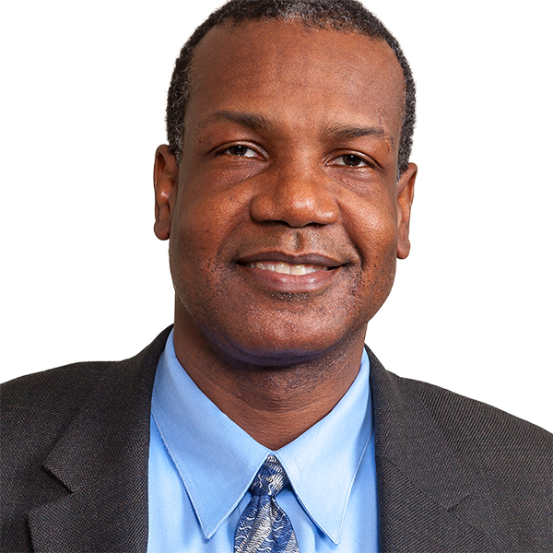
10
Greetings and Keynote Introduction
Monday, June 24th
Dr. Laurent Simon
NJIT Vice Provost for Undergraduate Studies, Professor of Chemical Engineering
Dr. Laurent Simon earned a Ph.D. in Chemical Engineering from Colorado State University in 2001 and joined the New Jersey Institute of Technology in the fall 2001. He acted as the Associate Director of the Pharmaceutical Engineering Program
from December 2006 to January 2013. Dr. Simon is the author of sixty-four research articles, two textbooks, seven book chapters, and has made more than sixty presentations. He is also a member of the American Institute of Chemical Engineers
and a reviewer for the American Mathematical Society.
In honor of his commitment to student success, Dr. Simon has received the Excellence in Teaching Award, Master Teacher Designation, Newark College of Engineering Saul K. Fenster Innovation in Engineering Education Award, and a Distinguished Teaching Award from the American Society of Engineering Education (ASEE). His research and teaching interests have included modeling, analyzing and controlling drug-delivery systems and absorption of chemical warfare agents. He is also a co-inventor of a drug-delivery device created to help with general patient compliance and to aid those with chronic conditions.
As the Vice Provost for Undergraduate Studies, Dr Simon is responsible for developing procedures to assist undergraduates from their first days on campus through graduation. These efforts include offering advising and tutoring that are beneficial to
their needs and aspirations, and assuring that other essential resources are available to support their academic progress.

Slide 11
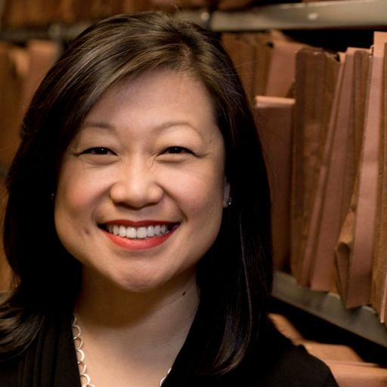
11
Keynote Speaker
Monday, June 24th
Sarah Chu
Director of Policy & Reform at Perlmutter Center for Legal Justice
Benjamin N. Cardoza Law School, Yeshiva University
As the director of policy and reform, Sarah leads the Perlmutter Center for Legal Justice's (PCLJ) forensic science policy initiatives. She served on the Scientific Inquiry and Research Subcommittee of the National Commission on Forensic Science and was the 2021 recipient of the Legal Aid Society’s Magnus Mukoro Award for Integrity in Forensic Science.
Prior to joining PCLJ, Sarah led the Innocence Project's policy portfolio on forensic science, forensic medicine, and police investigative technologies for 15 years.
A graduate of the University of California, San Diego, Sarah holds bachelor degrees in Biochemistry/Cell Biology, Communication, and a Masters in Biology. She also holds a Masters in Epidemiology from Stanford University and completed her doctorate in Criminal Justice at John Jay College of Criminal Justice/CUNY Graduate Center. Sarah is a member of the 2023-2024 class of the Harvard Medical School Center for Bioethics Fellowship Program.

Slide 12
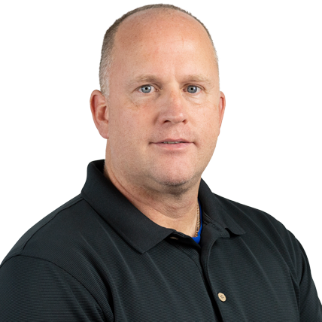
12
Kevin Parmelee, Ph.D.
Professor of Practice
NJIT Department of Chemistry and Environmental Science in the College of Science and Liberal Arts
parmelee@njit.edu
Before joining NJIT, Dr. Kevin Parmelee was a Detective in the Somerset County, New Jersey, Prosecutor’s Office Forensic Laboratory. Dr. Parmelee designed and implemented the Northeast Crime Scene Institute, which brings practitioners together from across the region for training and consultation.
He has over 23 years of law enforcement experience that includes a variety of policing duties with a primary focus on crime scene investigation, shooting reconstruction, arson investigation, footwear analysis, forensic photography, and latent print analysis. As a police officer and forensic science topic expert, Dr. Parmelee has testified in municipal and superior court numerous times.
Dr. Parmelee’s formal education includes a B.S. from St Francis University, PA, an M.A. in Public Administration and Human Resources from the University of Phoenix, and a Ph.D. in Criminal Justice from Capella University. He is certified as a Crime Scene Analyst (IAI), Certified Latent Print Analyst (IAI) and Forensic Photography (IAI). He is also trained in more advanced techniques related to operating in mass fatality scenes and CBRN-TIC related hazardous environments. He is also a former certified police instructor who routinely taught forensic topics to new law enforcement personnel.
DATE TIME LOCATION SESSION
Mon, 6.24.2024 1:30-3:00 pm GITC 1401 XR Lab Virtual Crime Scenes
Wed, 6.26.2024 10:10-11:50 am Tiernan Hall 209 Shooting Reconstruction

Slide 13
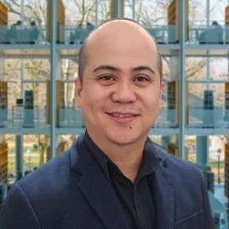
13
Joel Almoradie
Emerging Technologies Integration Specialist
Office of Digital Learning, IST Division
jpa46@njit.edu
Joel’s mission - to be in service of others - drives his fervor in supporting educators and empowering learners using his diverse, decades-long experience in higher education and information technology.
His extensive work experience from teaching in various modalities, distance education operations, LMS administration, educational technology, extended reality, and information technology consulting and management allow Joel to create thoughtful strategies for incorporating technology into education for a positive, equitable student learning experience.
DATE TIME LOCATION SESSION
Mon, 6.24.2024 1:30-3:00 pm GITC 1401 XR Lab Virtual Crime Scenes
(enter by Makerspace)

Slide 14
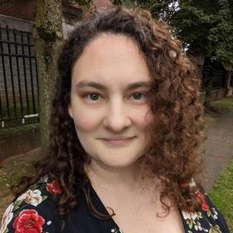
14
Dana Philipps, Ph.D.
Research Assistant
Union County (NJ) Prosecutor’s Office
Dana.Philipps@UCPO.org
With a Ph.D. in Biomedical Science from the University of Connecticut Health Center, postdoctoral work in genetics at Cornell University and a Supervisor Certificate in Educational Leadership and Administration from Rowan University, Dr. Philipps brings a wealth of expertise to the field of investigative genetic genealogy, blending a solid scientific foundation with a passion for unraveling family histories. Dana also has a robust teaching, mentoring and curriculum development background, having served as a science teacher at Westfield (NJ) Senior High School for over a fifteen years.
In February 2023, Dana joined the Union County Prosecutor’s Office to develop their in house genetic genealogy unit, which is dedicated to solving cold cases through advanced genetic analysis. In her current role in the Union County Prosecutor’s Office Forensic Laboratory, she continues to educate members of the team at UCPO and the public about investigative genetic genealogy. Dana is also a member of the Association of Professional Genealogists.
DATE TIME LOCATION SESSION
Tues, 6.25.2024 8:30-10:00 am Eberhardt Hall 112 Genetic Genealogy Part I - bring your laptop
Tues, 6.25.2024 10:10-11:50 am Eberhardt Hall 112 Genetic Genealogy Part II

Slide 15
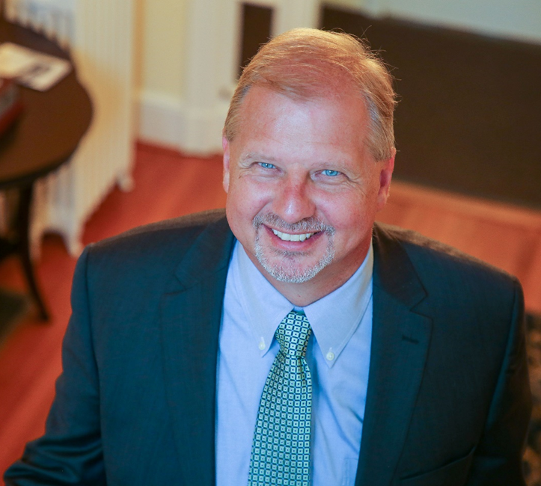
15
Academic Greetings and Keynote Introduction
Tuesday, June 25th
Dr. John Pelesko
Provost and Senior Vice President for Academic Affairs
New Jersey Institute of Technology
John A. Pelesko joined the New Jersey Institute of Technology as Provost and Senior Vice
President for Academic Affairs on August 1, 2023. An NJIT alumnus, Pelesko earned his Ph.D.
in mathematical sciences from the university in 1997.
After serving as a Von Karman Instructor at the California Institute of Technology, he spent several years on the faculty at the Georgia Institute of Technology. In 2002, Pelesko joined the faculty of the University of Delaware. In a 21-year career at UD, he served as Chair of the Department of Mathematical Sciences, Associate Dean for the Natural Sciences, and, most recently, Dean of the College of Arts and Sciences, UD’s largest college.
He is the author of numerous scientific papers and three books, the most recent of which, “Unlocking the Mystery: Mathematical Modeling in Secondary Classrooms”, was released in late 2022. At NJIT, he has co-led the development of the institution’s new strategic plan and looks forward to working to enhance student and faculty success in the years ahead.

Slide 16
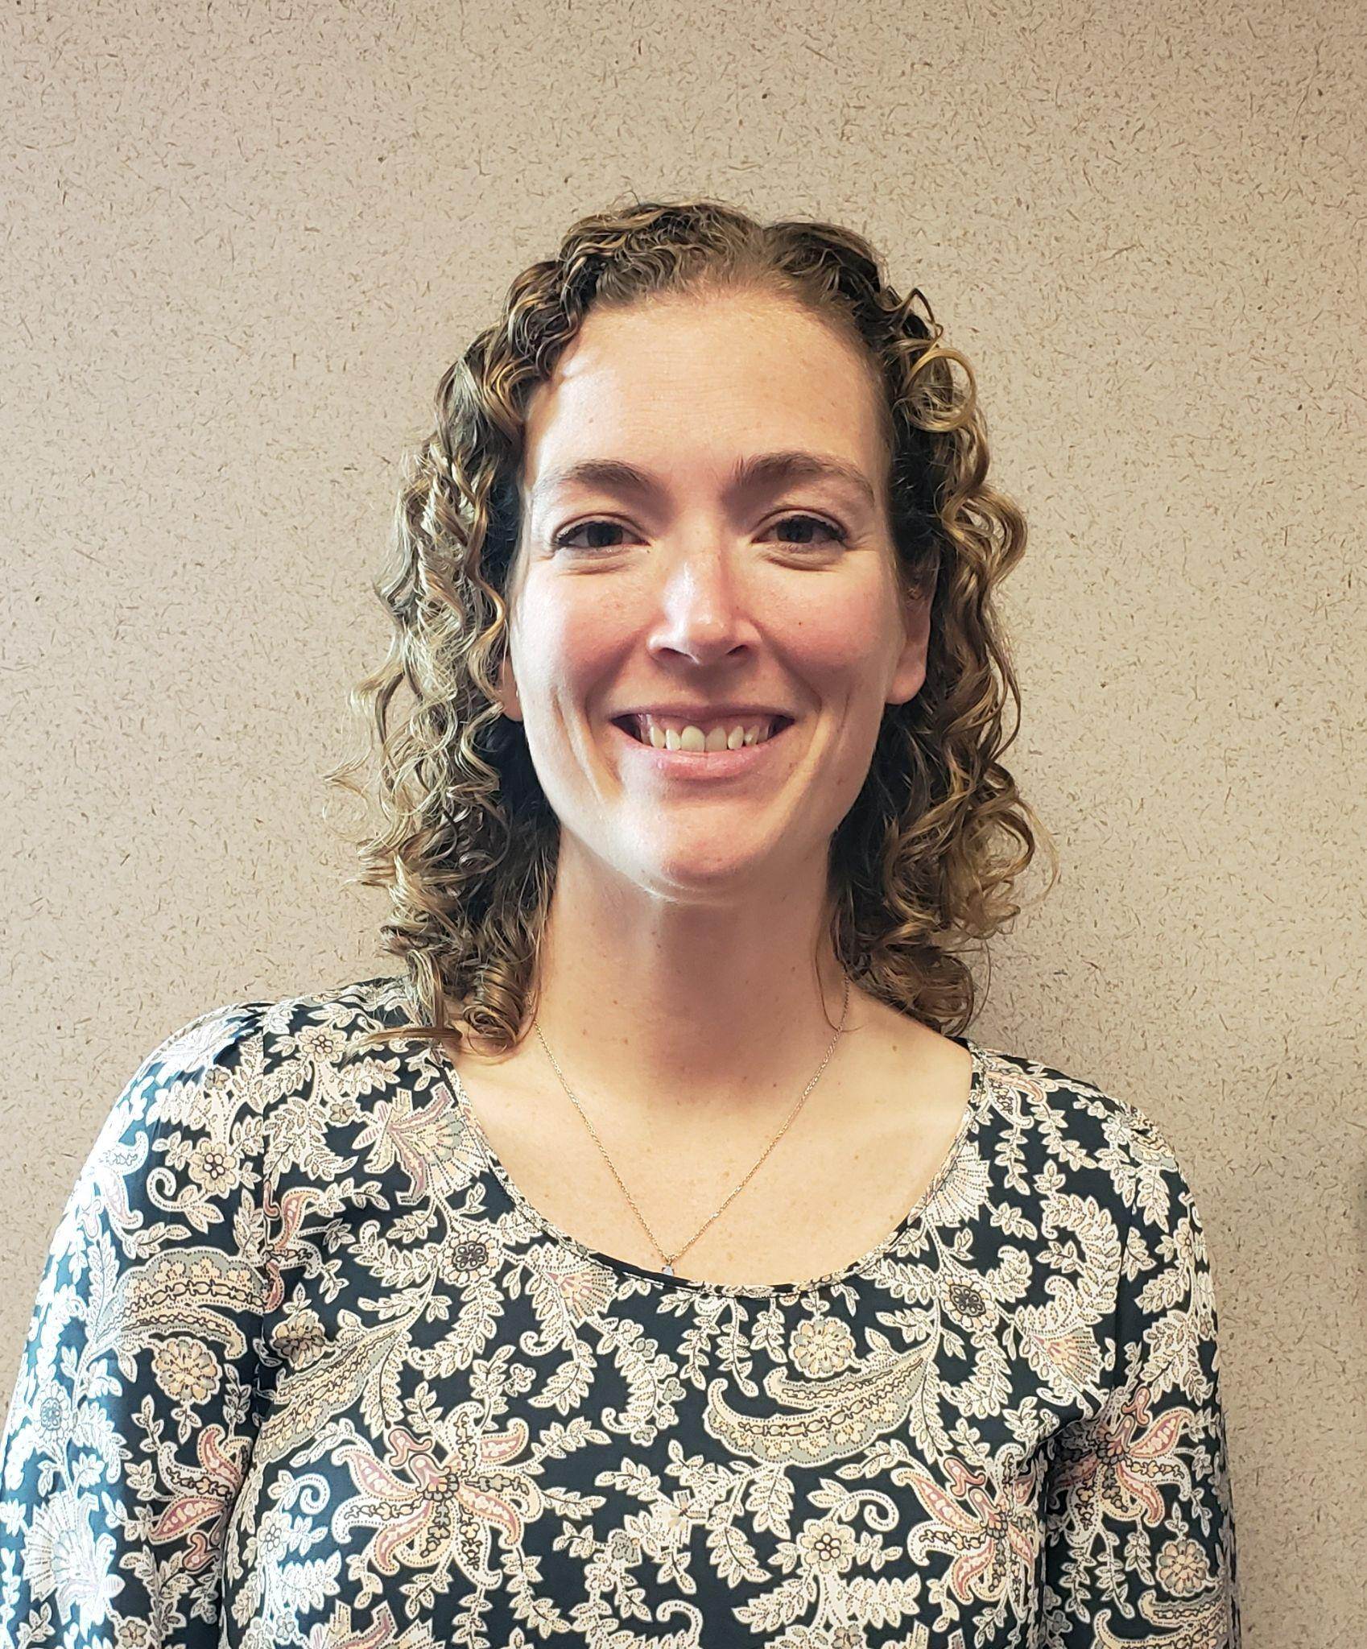
16
Keynote Speaker
Tuesday, June 25th
Britton Morin
Laboratory Director, Union County (NJ) Prosecutor’s Office Forensic Laboratory
Britton is an experienced DNA analyst and laboratory manager. Since 2016, she has served as the Laboratory Director at the Union County Prosecutor’s Office Forensic Laboratory, where she supervises Forensic Biology and Controlled Dangerous Substances sections.
She holds a Bachelor of Science degree in Biochemistry from the University of Delaware and a Master of Science in Forensic Science from Pace University. She also serves on the advisory board for the Union County Sexual Assault Response Team and is a member of the NIST Expert Working Group for Human Factors in Forensic DNA Interpretation.
Prior to joining UCPO, she was a criminalist for the NYC Office of the Chief Medical Examiner Department of Forensic Biology, working in both the Homicide/Sex Crimes and Property Crimes Groups, and was also the DNA Technical Leader at NMS Labs, a private forensic testing agency. She also served as an adjunct professor at Arcadia University, giving graduate level lectures and serving as an advisor on graduate thesis projects.

Slide 17
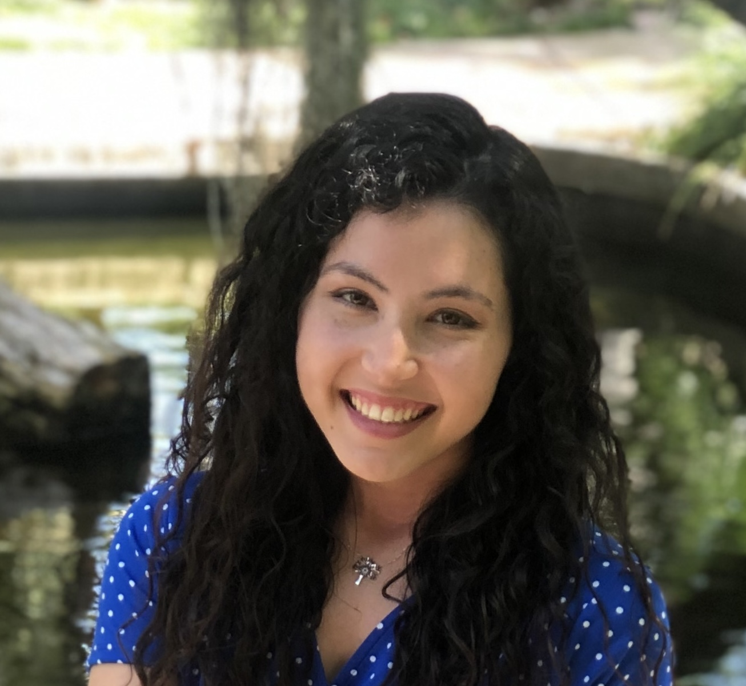
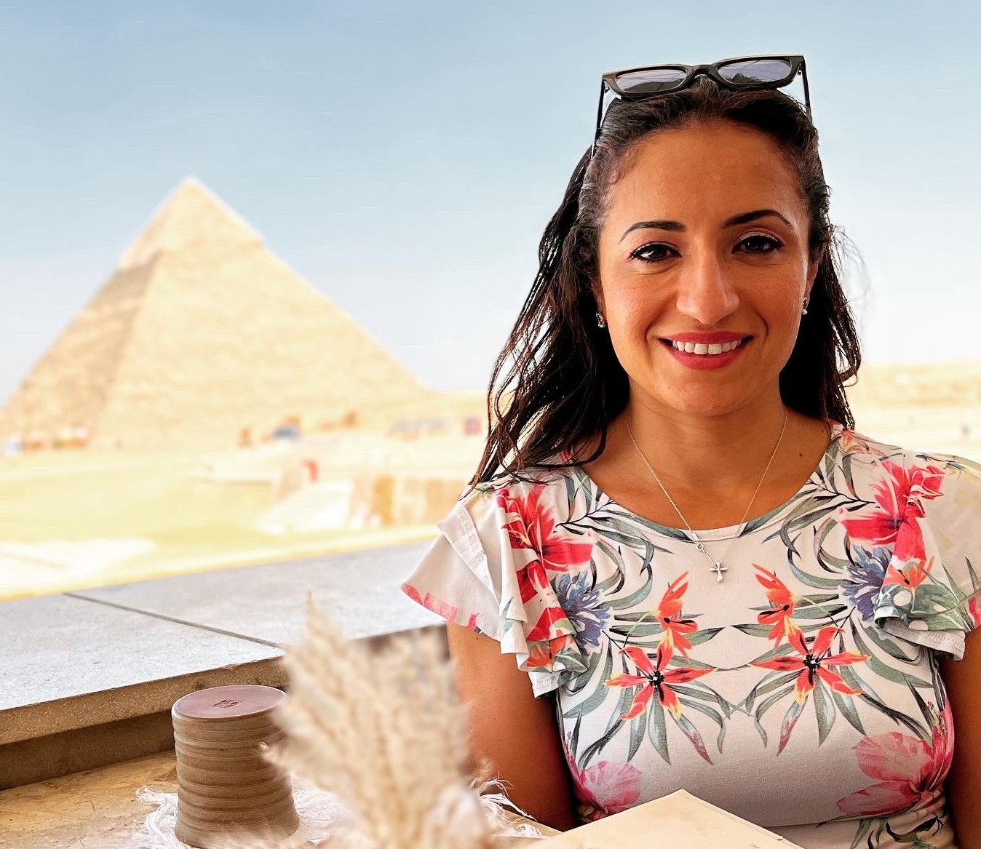
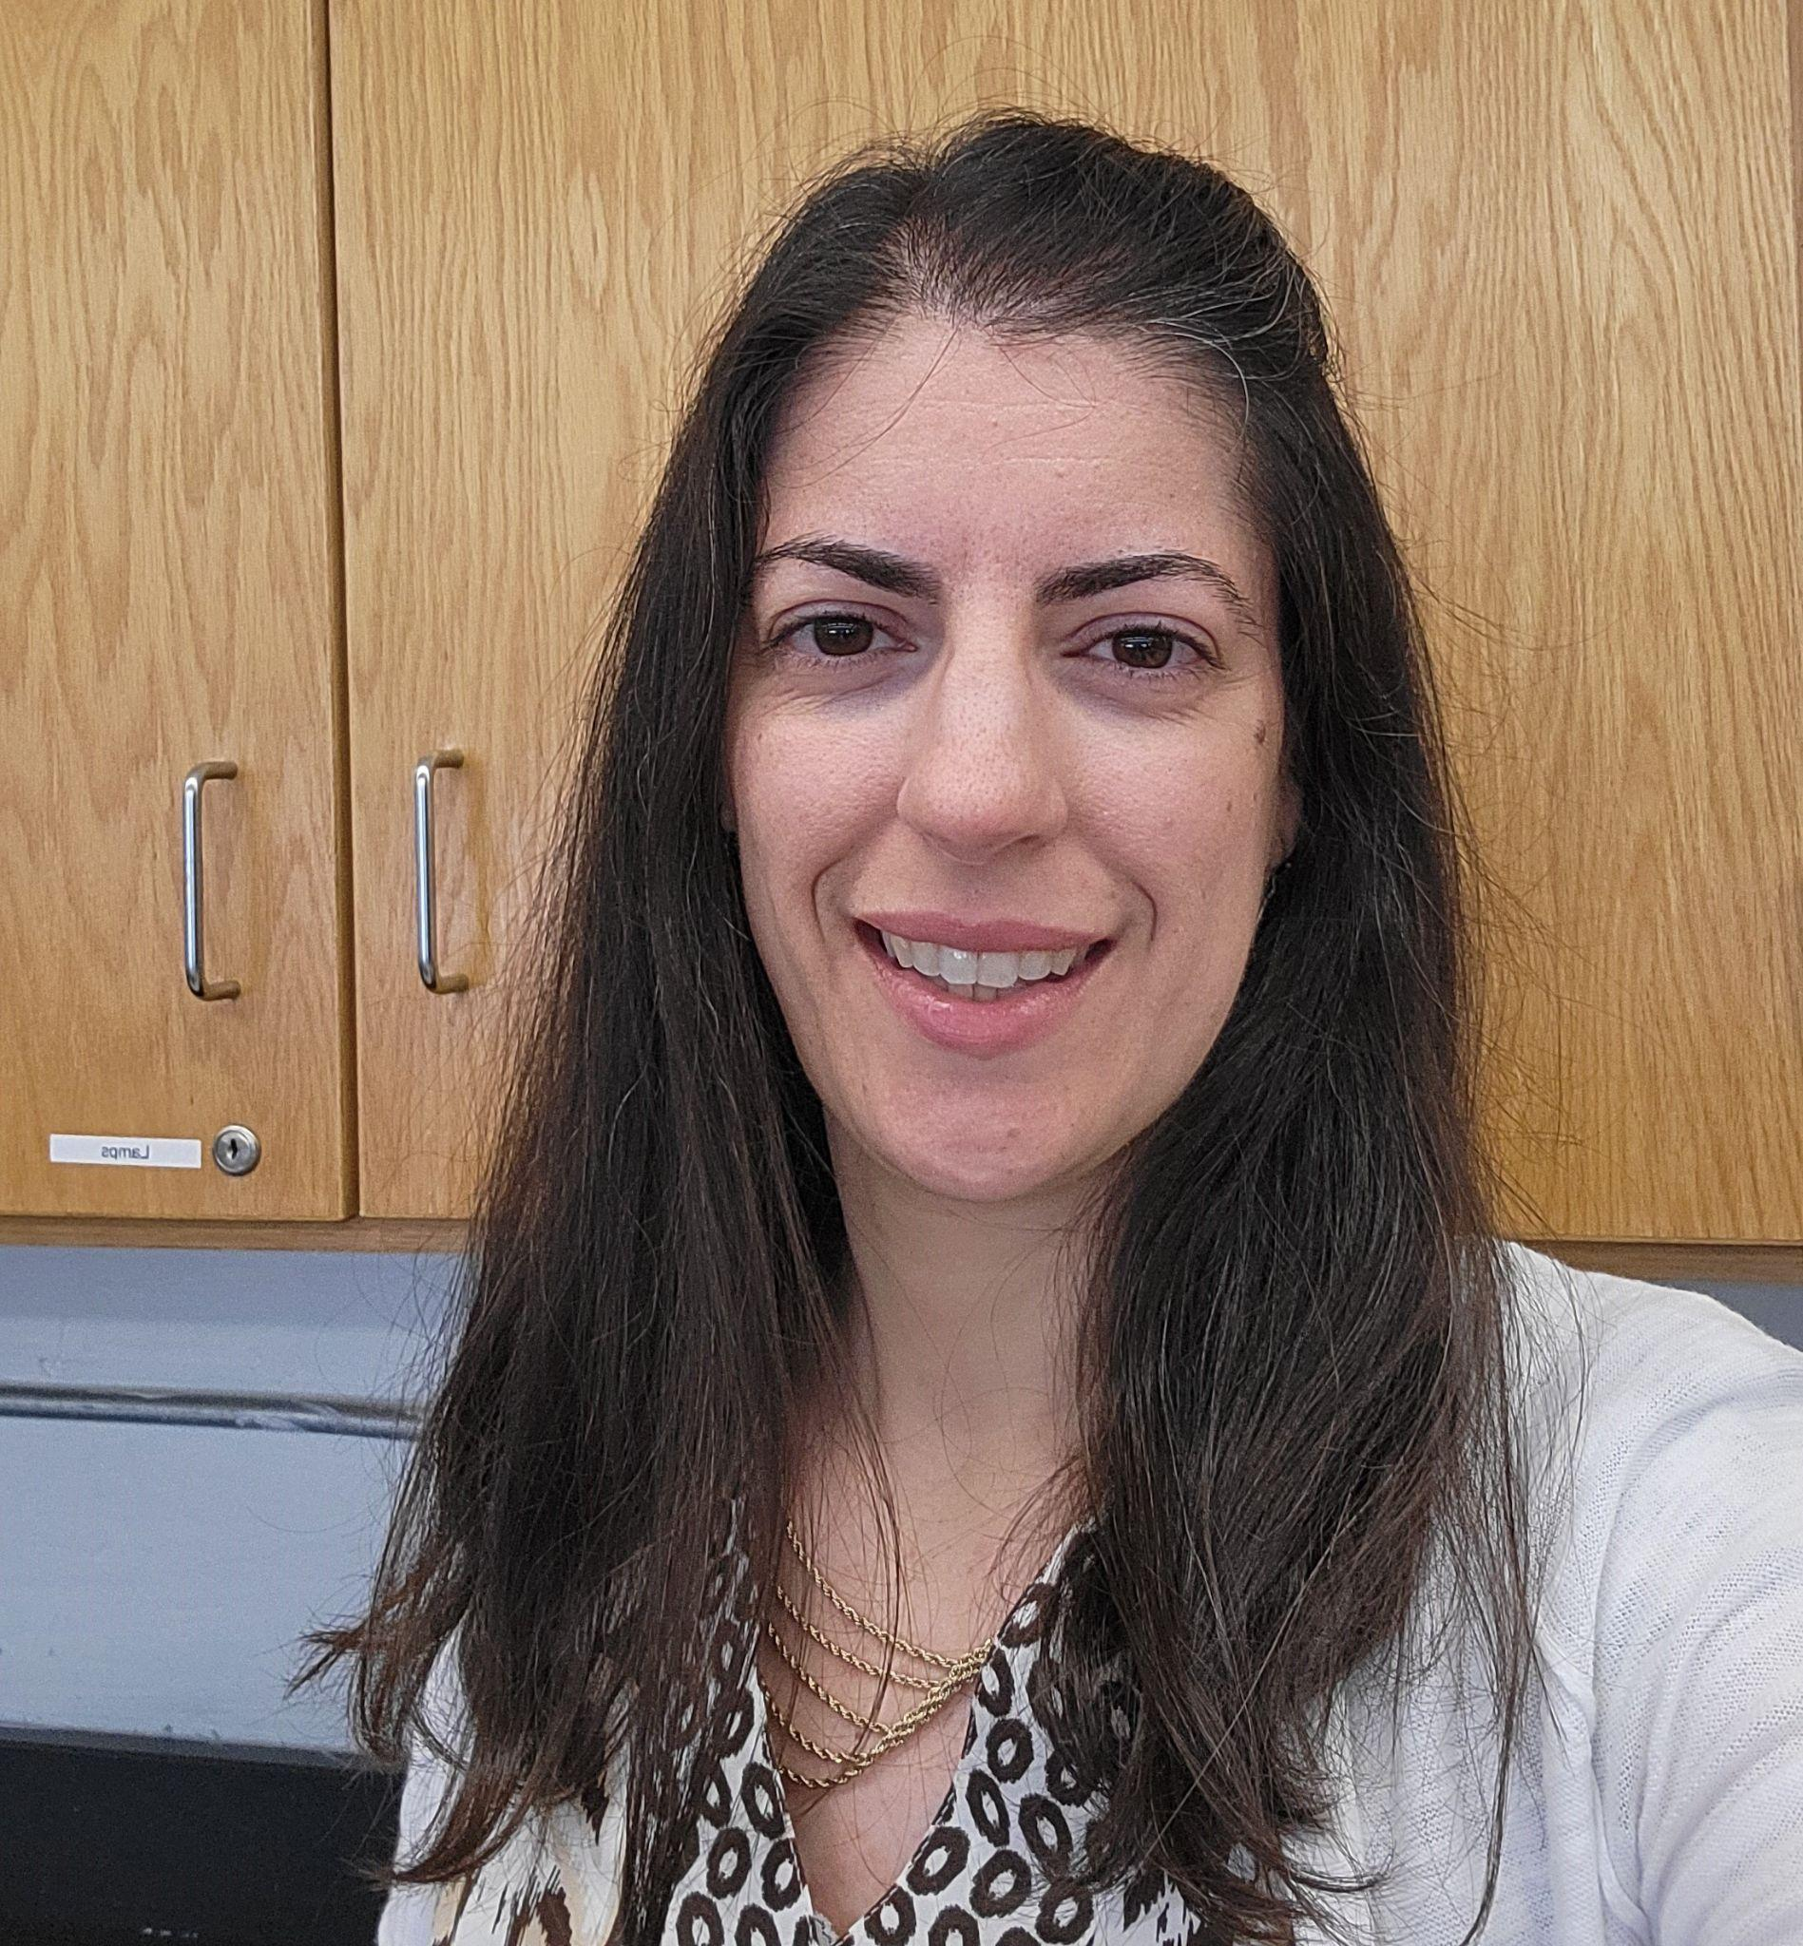
17
Forensic Science Initiative Teacher-Leaders
Sarah Campos Crstina Rageb Gayed Teresa Tenreiro
Newark Vocational High School Ridgewood High School Hillside High School
Newark, NJ Ridgewood, NJ Hillside, NJ
s1campos@nps.k12.nj.us cgayed@ridgewood.k12.nj.us ttenreiro@hillsidek12.net
Sarah just finished her fifth year teaching high school science. She currently teaches 9th grade Biology and 12th grade dual enrollment Forensic Science with NJIT. Sarah has been teaching at Newark Vocational High School in Newark New Jersey for all of her teaching career and loves it! She says she loves science education because she gets to instill in her students the curiosity to question and problem-solve.
Sarah earned her B.A. in Secondary Science Education from University of Delaware and M.A. in Educational Leadership from William Paterson University.
She looks forward to continuing her work as an educator and a leader through programs like FRSC 201 Dual Enrollment with NJIT!
A high school biology teacher for the past 11 years, Crstina was born in Egypt and moved to the U.S. at the age of 14. She lived in Los Angeles and went to University of California, Irvine for a B.S. in Biology.
She married and moved to New Jersey, obtaining her MAT at Montclair State University via the Newark-Montclair Urban Teacher Residency Program. At Technology High School in Newark, Crstina taught a variety of CTE Biomedical Science courses using the PLTW curriculum for 9 years, as well as Forensic Science. She currently teaches Biology, Advanced Biology and Anatomy and Physiology at Ridgewood High School. She’s the HOSA advisor for future health professionals.
Crstina has two children, ages 5 and 8. She loves to exercise. Spare time relaxation means watching scary movies.
Teresa is a science teacher at Hillside High School in New Jersey. She has been teaching science at Hillside for 21 years, specifically biology honors and college prep classes in environmental earth science and forensic science. She currently teaches the dual-enrollment course Introduction to Forensic Science course with NJIT.
Teresa earned her B.A. and M.A. at Kean University in Biology Education and School Counseling.
She’d like you to know she is honored to be a part of the FSI cohort and is eager to share her experiences during our conference.
DATE TIME LOCATION SESSION
Wed, 6.26.2024 8:30-10:00 am Tiernan Hall 209 Investigating the MicroUniverse
Wed, 6.26.2024 2:05-3:00 pm Eberhardt Hall 112 Takeaways: How Does What We Learned Work in Middle and High School Classrooms?

Slide 18
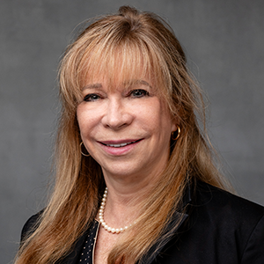
18
Keynote Introduction
Wednesday, June 26th
Holly Stern, Esq.
General Counsel and Vice President, Legal Affairs
New Jersey Institute of Technology
Holly Stern, currently serving as New Jersey Institute of Technology’s Vice President and General Counsel, has worked at NJIT for over 31 years, in positions of increasing responsibility. In 2004, she officially became General Counsel, and later attained the position of Vice President and General Counsel, serving on the President’s leadership team.
She also serves as Secretary to the Board of Trustees for NJIT.
Prior to coming to NJIT, Ms. Stern worked in both the public sector and in private law firms. She leads a team of highly
dedicated professionals, including five attorneys, and three paraprofessionals. After graduating from Stanford University with a degree in political science, Ms. Stern attended the University of Southern California Law Center where she received a joint JD and Masters of Public Administration. She then began her legal career in New Jersey.
Following a judicial clerkship, she began practicing law in New Jersey to the present time, primarily in in-house positions.
Ms. Stern has, over the course of her career spoken on higher education legal and employment related matters, presenting before both the National Association of College and University Attorneys (NACUA) and College and University Professional Association. She has previously served on the Montville Township Board of Education in the 1990’s, and on the District XI Ethics Committee.
Ms. Stern is a resident of West Orange New Jersey since 2010, where she lives with her partner and their rescue dog. She has two grown children, Julianne and David, (neither of whom are lawyers!) and two grandchildren, Roy and June.

Slide 19
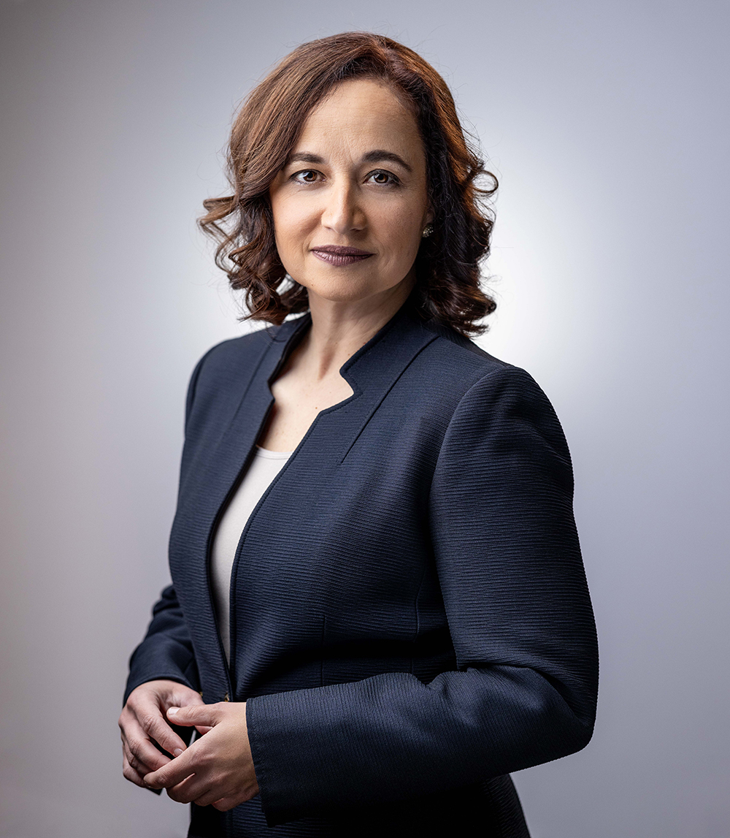
19
Keynote Speaker
Wednesday, June 28th
Jennifer Sellitti, J.D.
New Jersey Public Defender
Jennifer Sellitti was sworn in as Public Defender on February 1, 2024. Prior to becoming Public Defender, Jennifer served as Director of Training & Communications for OPD. She previously served as Deputy of OPD’s Middlesex Trial Region and as an Assistant Deputy Public Defender in the Essex County Adult Region. Jennifer worked as a staff attorney for the Committee for Public Counsel Services in Massachusetts and as a Massachusetts Superior Court law clerk before joining OPD. She began her legal career at Massachusetts Correctional Legal Services, where she worked on the organization’s Prison Brutality Project investigating claims of prison violence and representing inmates housed in solitary confinement at super maximum-security prisons in civil rights lawsuits. She had a career in marketing and public relations before becoming a lawyer.
Jennifer has trained lawyers in more than thirty-five states and speaks nationally about trial advocacy and transforming public defense systems. She is a trustee of the Association of Criminal Defense Lawyers of New Jersey, serves on the Advisory Board of New Jersey Institute of Technology’s Forensic Science Major, and is a member of the New Jersey State Bar and the National Association of Criminal Defense Lawyers. She is graduate of Suffolk University Law School and obtained a B.S. degree in public relations from Boston University.
When she is not advocating for public defender staff and clients, she and her partner operate D/V Tenacious, a dive vessel that locates, dives, and recovers artifacts from shipwrecks in the North Atlantic. Jennifer is a certified diver and a U.S.C.G. licensed ship captain. She is a New Jersey Maritime Museum trustee.

Slide 20
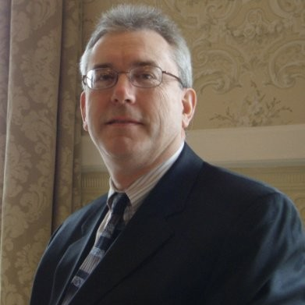
20
John Osborn
Forensic Document Examiner
Osborn & Son
osbornandson.com
John Paul Osborn is a forensic document examiner and expert witness in the areas of handwriting, hand printing and signature identification, document alteration, identification of machine printed documents including photocopies, non-destructive paper, ink and indentation analysis and all other problems involving physical evidence on documents.
John is the fourth generation of a family practicing in this field for more than 100 years. His great grandfather authored the highly regarded text "Questioned Documents," as well as "The Problem of Proof," "Mind of the Juror," and "Questioned Document Problems." John received his initial training in the field from his father, Paul Albert Osborn, and has been a full time document examiner for more than twenty five years.
John was granted full membership status in the American Society of Questioned Document Examiners (www.asqde.org) in 1989 after completing the required testing. He is currently President of the ASQDE and leads its Executive Committee which administrates this seventy-two year old professional organization.
John was granted certification by the American Board of Forensic Document Examiners (www.abfde.org) after completing the required testing by that Board in 1990. The ABFDE is an internationally recognized and accredited certification board (accredited by the Forensic Specialties Accreditation Board). The ABFDE requires recertification of its members every five years. John completed his last recertification in 2010.
John also was a working member of the Scientific Working Group for Document Examination in the late 1990s. Currently John is serving on the Questioned Documents subcommittee of the Physics/Pattern Scientific Area Committee overseen by the National Institute of Science and Technology (NIST is an agency of the U.S. Dept. of Commerce). NIST is continuing the work of the Scientific Working Groups in terms of the development and publication of standards and guidelines in the forensic sciences.
DATE TIME LOCATION SESSION
Wed, 6.26.2024 1:15-2:05 pm Eberhardt Hall 112 Forensic Document Examination

Slide 21
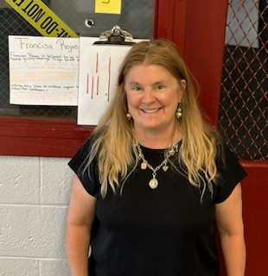
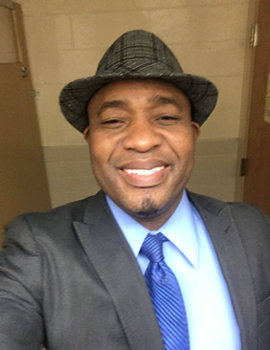
21
Forensic Science Initiative Teacher-Leaders
Danielle Kelly Dr. Gustave Ado
University High School Weequahic High School
Newark, NJ Newark, NJ
D1kelly@nps.k12.nj.us G2ado@nps.k12.nj.us
With 24 years of teaching experience, Danielle Kelly has certifications in biology, general science, and special education, along with a master’s degree in Teaching.
Teaching at University High School for the past 13 years, she has had the opportunity to teach middle school and high school core subjects and electives, now primarily forensic science. She has worked on curriculum development for various sciences within the Newark School district, has mentored many new teachers and student teachers, and is the current Union Representative for University High School.
Mrs. Kelly lives in Livingston with her husband and four children and enjoys playing soccer, golfing, and spending time with her family.
Dr. Gustave Ado has 23 years of experience teaching biology, anatomy and physiology, medical terminology, forensic science, and health science courses to high school and college students. He currently teaches at Weequahic High School in Newark.
Dr. Ado completed a doctorate in Science Education (Ed.D.) at Teachers College, Columbia University. His prior training includes an undergraduate degree in Biological Sciences and a master’s in Science Education.
Additionally, he engages in research that focuses on how to teach controversial science topics, such as HIV/AIDS, within the science curriculum. Dr. Ado believes that HIV/AIDS education can be integrated into the school-based science curricula and taught by science teachers in order to better address children’s sexual health.
DATE TIME LOCATION SESSION
Wed, 6.26.2024 2:05-3:00 pm Eberhardt Hall 112 Takeaways: How Does What We Learned Work in Middle and High School Classrooms?

Slide 22
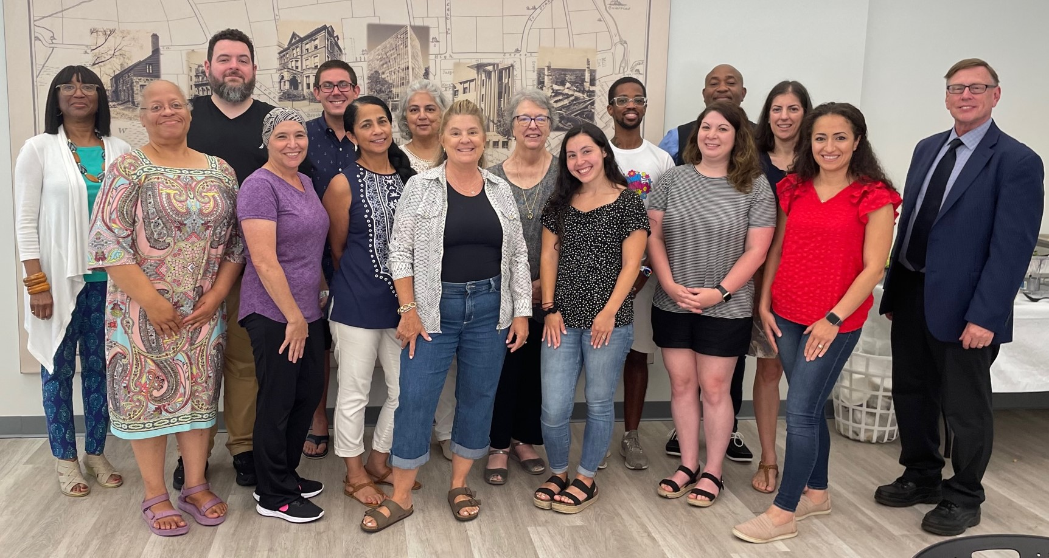
22
NJIT Forensic Science Initiative (FSI) Teacher Prep Program
https://www.njit.edu/precollege/teacher-prep-program-forensic-science
The NJIT Forensic Science Initiative (FSI) Teacher Prep Program helps teachers prepare to teach forensics to high school students. Teachers completing the program can be qualified to teach FRSC 201 Introduction to Forensic Science as a dual enrollment course using the NJIT syllabus.
Forensic Science as a high school course can open many options in higher education for students. And, thanks to the many TV shows featuring forensic science, it’s attractive to them, too. Students who might not otherwise see themselves as capable scientists can benefit, especially, from the science they’ll learn in the foundation course in our BS in Forensic Science program.
The FSI Teacher Prep Program is open to high school teachers who teach Juniors and/or Seniors. Teachers need a Masters Degree in an appropriate science field or equivalent experience, NJ teacher certification in one of the sciences, and a passion for learning.
Professional development in a cohort model takes place on the NJIT campus in the summer with on-going support during the school year. It includes content lessons in several branches of forensic science, curriculum mapping, and lesson development tailored to high school students’ needs. The program is led by Barbara Elder Weller, Ed.D. (she, her), Senior Director, Program Development and Forensic Science Initiative in the NJIT Center for Pre-College Programs.
The initial phase of the program was underwritten by a Governor’s Emergency Education Relief Fund (GEERF II) grant from the NJ Office of the Secretary of Higher Education.
FSI Teacher Prep Program teachers presenting at this conference: Support provided by their colleagues:
Dr. Gustav Ado, Weequahic High School, Newark Mrs. Dy-Anni Austin, STEM Innovation Academy of the Oranges, Orange
Ms. Sarah Campos, Newark Vocational High School, Newark Mrs. Kayla Belen, Phillipsburg High School, Phillipsburg
Mrs. Crstina Rageb Gayed, Ridgewood High School, Ridgewood Mrs. Leilani Bhoomz, Science Park High School, Newark
Mrs. Danielle Kelly, University High School, Newark Ms. Damaris Frederique, Central High School, Newark
Ms. Teresa Tenreiro, Hillside High School, Hillside Mr. Christopher Kirby, Science Park High School, Newark
Dr. Oksana Hnatczuk, Arts High School, Newark
Mr. Steve Vega, Kearny High School, Kearny
FSI Teachers Summer 2023 Joining them this summer:
Ms. Elizabeth Lozada, Global Studies High School, Newark
Ms. Esther Osasogie, Malcolm X. Shabazz High School, Newark

Slide 23
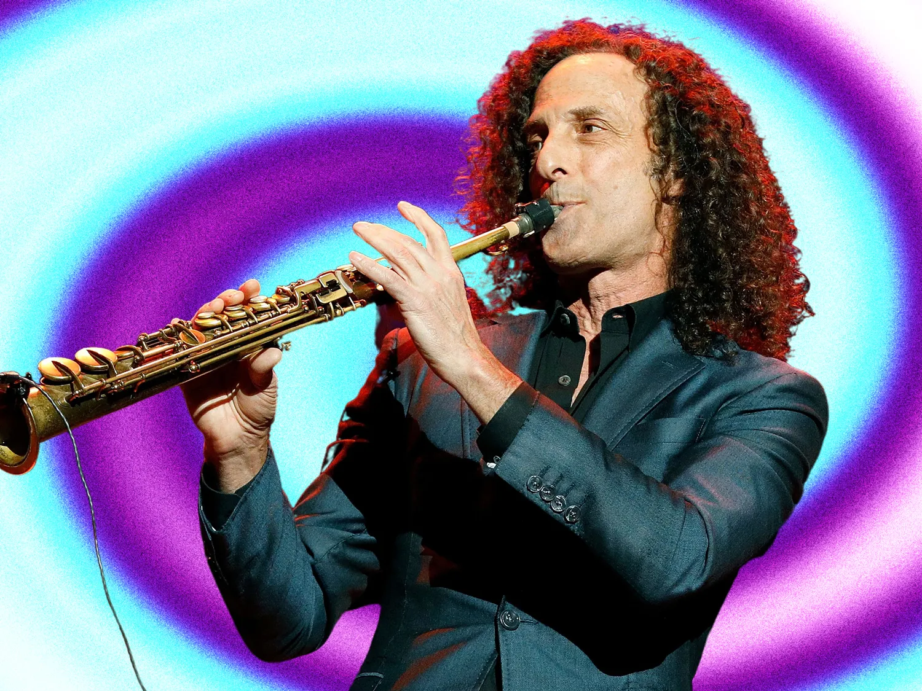
Sampling of New Jersey/New York Events
June 24-26, 2024
23
Shaq Hester & Trejah Bostic: You’ve Got a Friend- A Tribute to Donny & Roberta
Mon, Jun 24, 9:30 PM
The Public Theater & Joe's Pub
425 Lafayette Street, New York, NY
Southern-bred soul artists Trèjah Bostic and Shaq Hester pay tribute to the great legends Roberta Flack and Donny Hathaway.
Justin Timberlake
Tue, Jun 25, 8 PM
Madison Square Garden
4 Pennsylvania Plaza, New York, NY
Justin Timberlake
Wed, Jun 26, 8 PM
Madison Square Garden
4 Pennsylvania Plaza, New York, NY
Kenny G
Tue, Jun 25, 7 PM
Ocean City Music Pier
825 Boardwalk, Ocean City, NJ
Kenny G, is an American smooth jazz saxophonist and composer. He is one of the best-selling artists of all time, with global sales totaling more than 75 million records.
Beautiful: The Carole King Musical
Wed, Jun 26, 7:30 PM
Paper Mill Playhouse
22 Brookside Dr, Millburn, NJ
Caifanes and Café Tacvba - North America Tour
Wed, June 26, 7-10 PM
SummerStage Festival in Central Park
Rumsey Playfield, New York, NY
These two legendary Mexican bands, are embarking on their first-ever joint tour in the U.S. to celebrate their legacies and showcase the power of Mexican rock.
Comedy Cellar
Mon, Jun 24, sessions: 7:30 PM, 9:30 PM, 11:30 PM
117 MacDougal St, New York, NY
Woolf Works - American Ballet Theatre
Tues, Jun 25, 7:30 PM
Metropolitan Opera House
30 Lincoln Center Plaza, New York, NY
Wayne McGregor’s award-winning ballet triptych Woolf Works recreates the emotions, themes, and fluid style of three of Virginia Woolf’s novels: Mrs. Dalloway, Orlando, and The Waves.
PVRIS
Mon, Jun 24, 6 PM
Irving Plaza
17 Irving Pl, New York, NY
Pvris is an American pop rock band formed in Lowell, Massachusetts in 2012.
Woolf Works - American Ballet Theatre
Wed, Jun 26, 7:30 PM
Metropolitan Opera House
30 Lincoln Center Plaza, New York, NY
Wayne McGregor’s award-winning ballet triptych Woolf Works recreates the emotions, themes, and fluid style of three of Virginia Woolf’s novels: Mrs. Dalloway, Orlando, and The Waves.
Monday Public Skate
Mon, Jun 24, 6-8 PM
Branch Brook Park Roller Skating Center
Clifton Ave, 7th Ave., Newark, NJ
Blue Man Group
Tue, Jun 25, 7 PM
Astor Place Theatre
434 Lafayette St, New York, NY

Slide 24
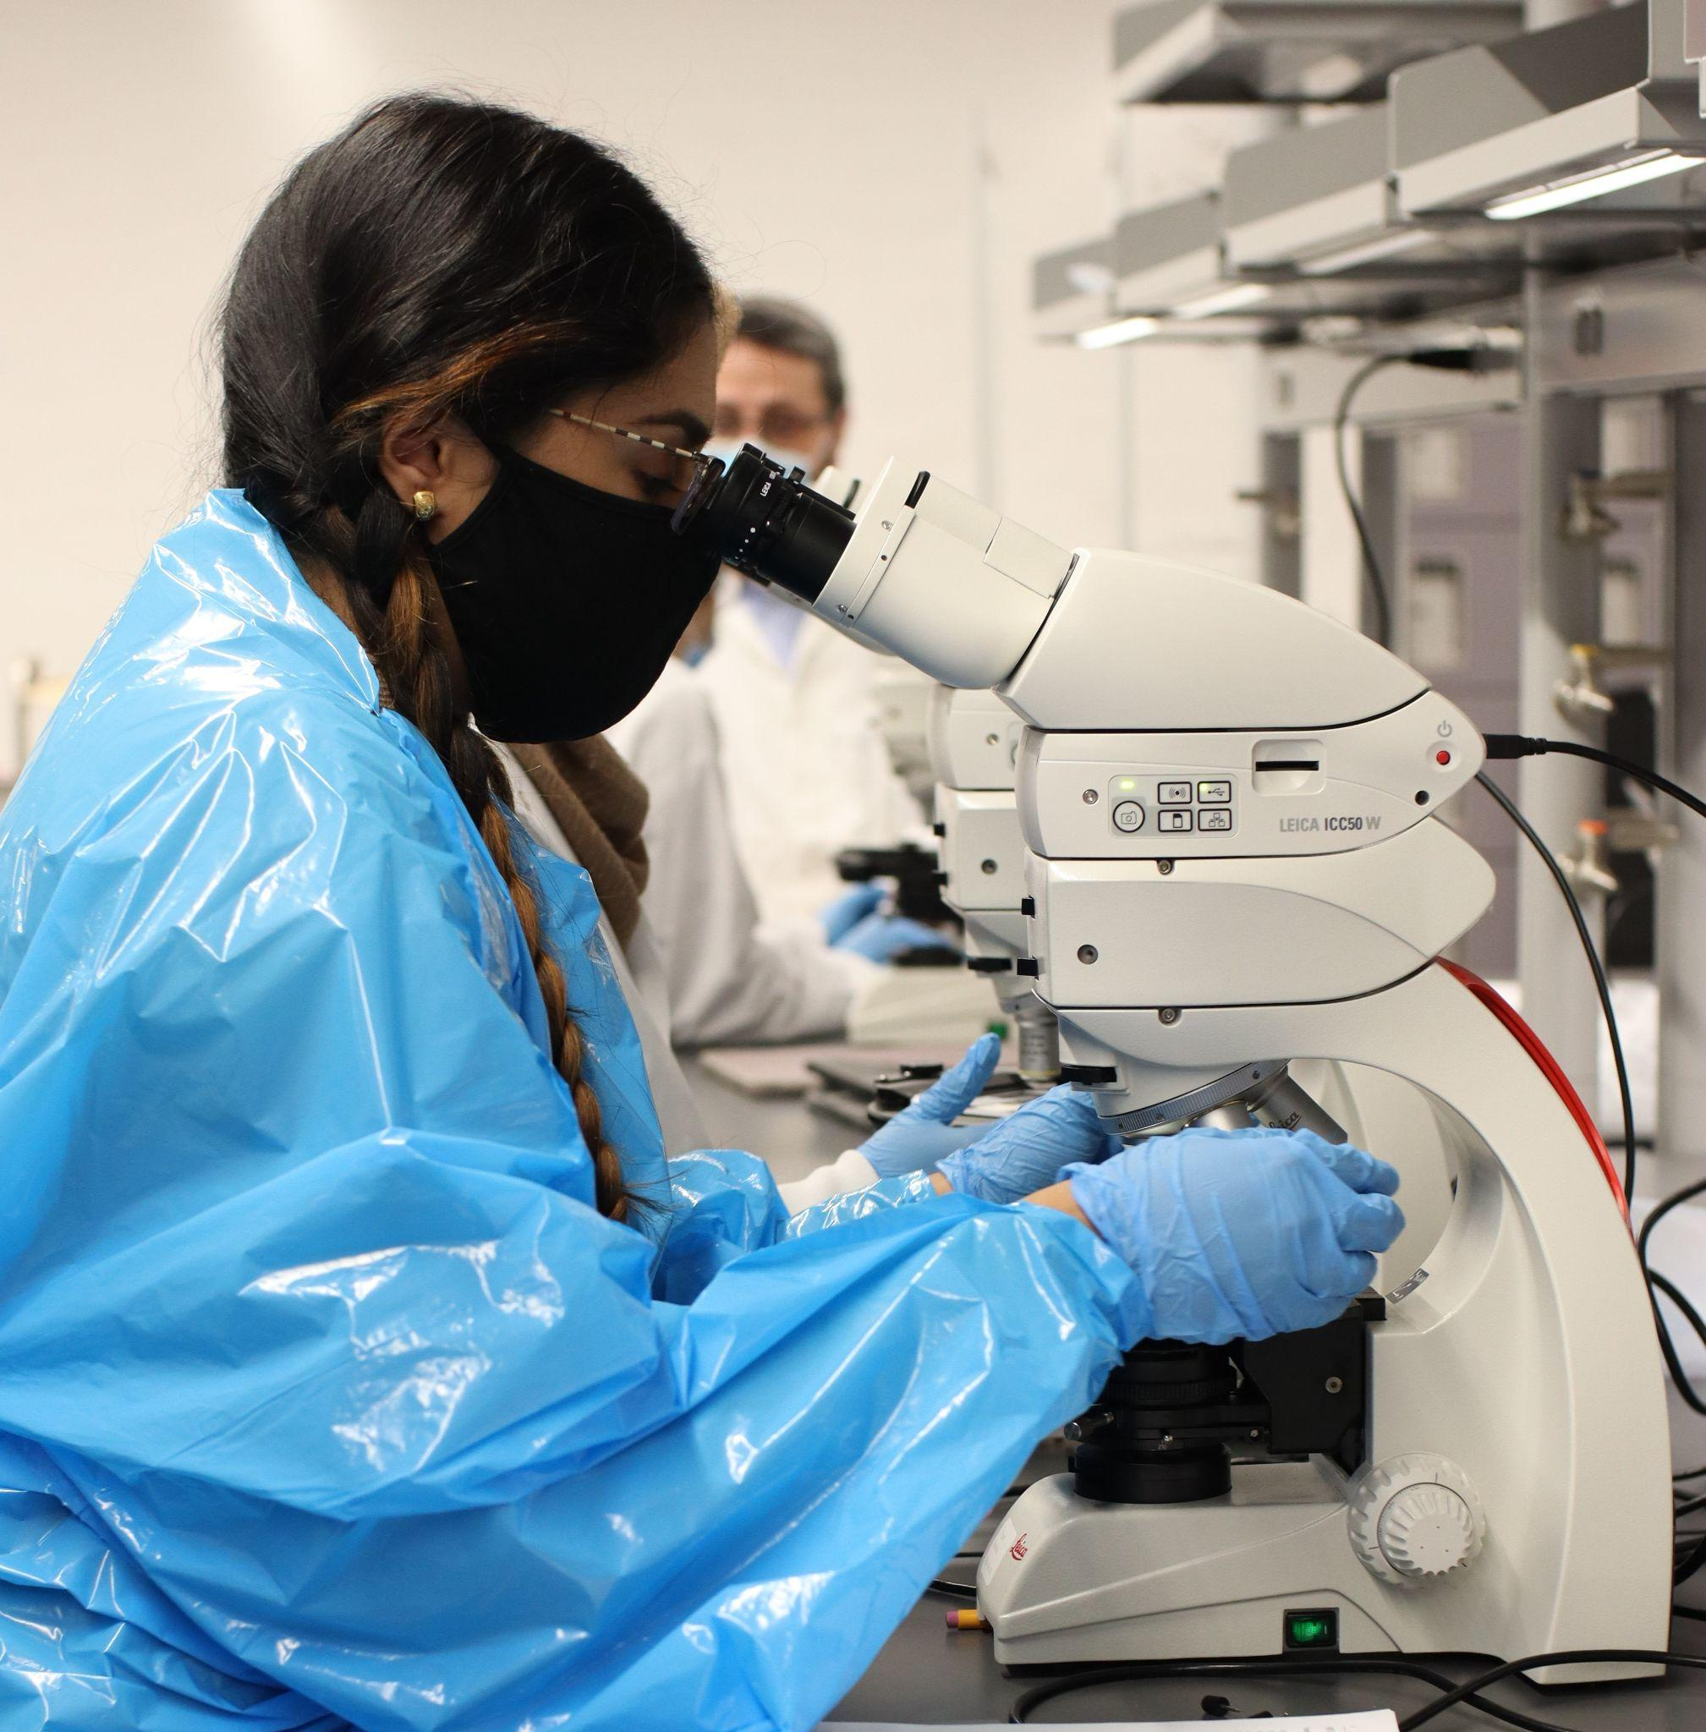
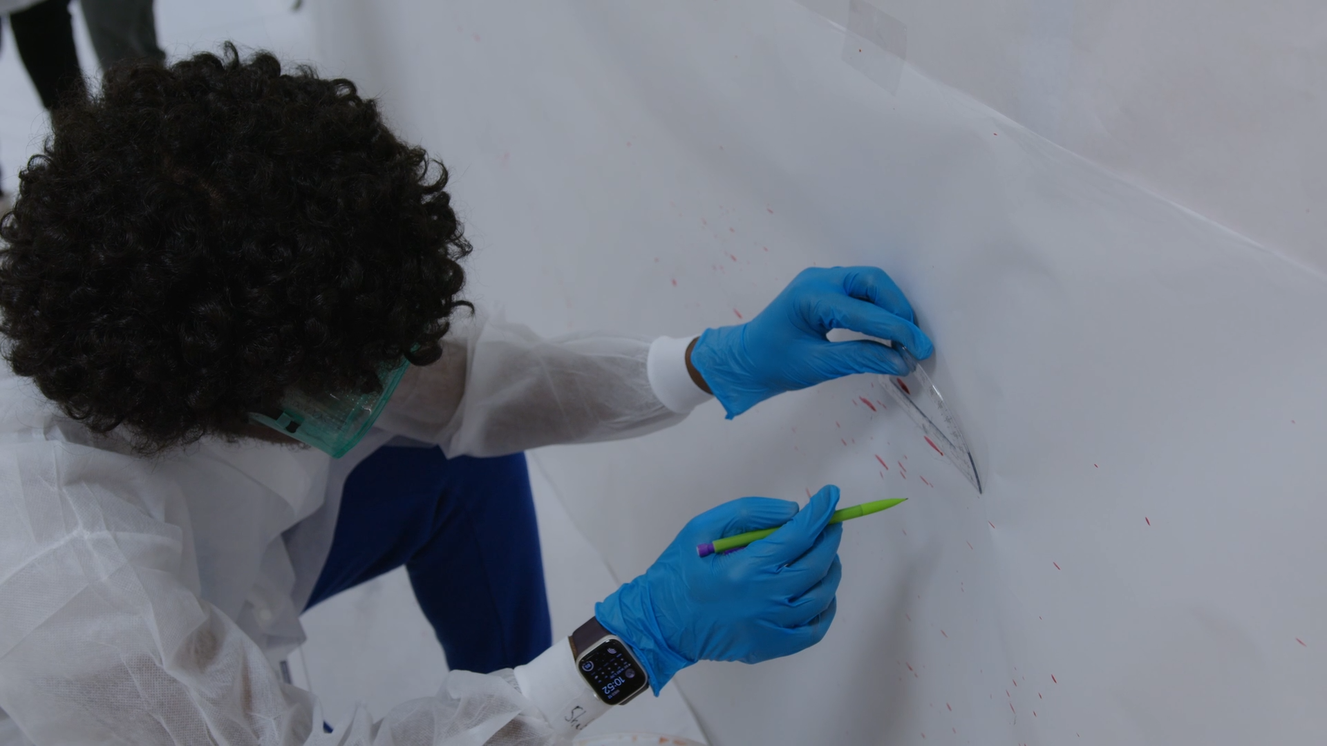
5648) or email (joshua.newkold@avantorsciences.com)
New Jersey Forensic Science Education Conference
24
ACKNOWLEDGEMENTS
We are grateful for support from:
Dean’s gift, NJIT College of Science and Liberal Arts
For more information:
The New Jersey Institute of Technology – NJIT
Degree programs in Forensic Science at NJIT
The Center for Pre-College Programs
The Forensic Science Initiative Teacher Prep Program
FSI in action

Slide 25
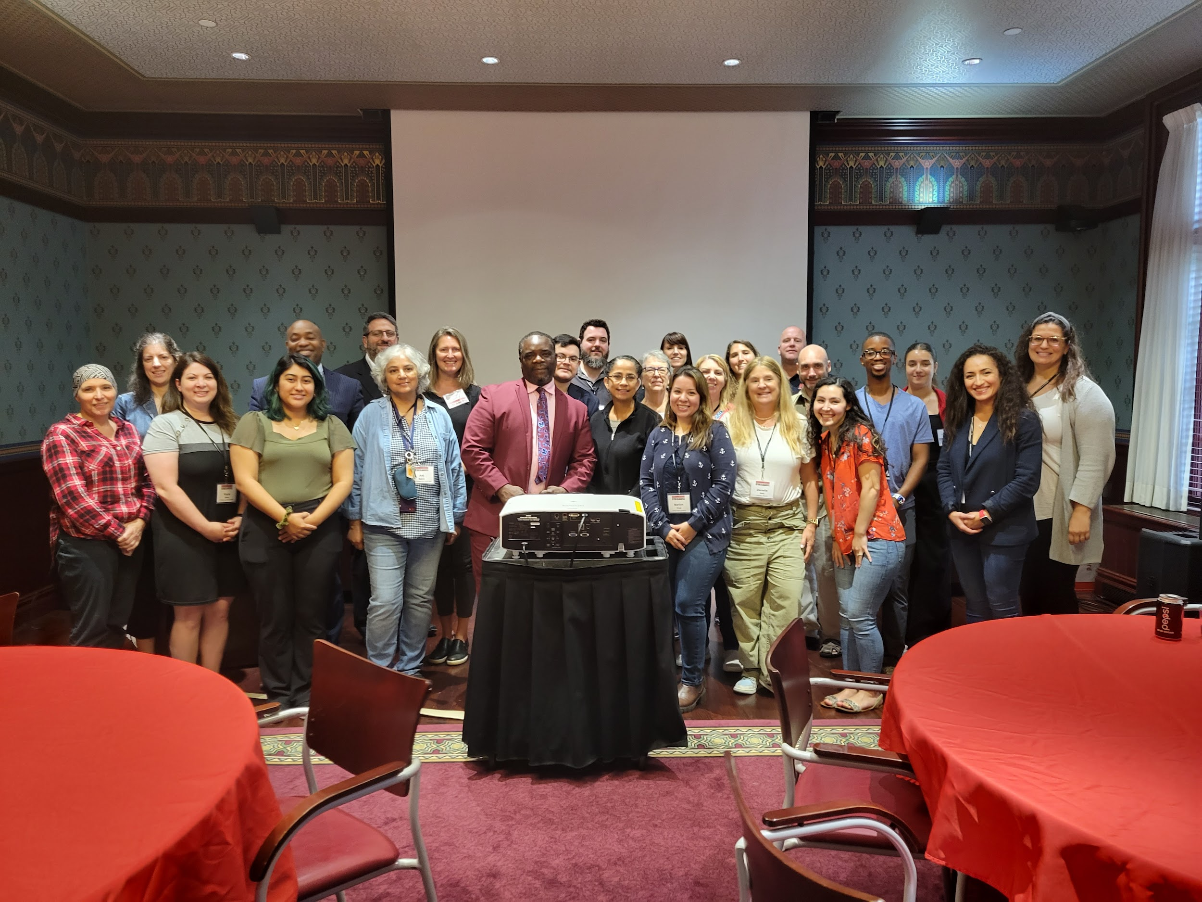
https://forms.gle/HwAa5LU2hbixhVzK8
25
Thank you for participating in the NJ Forensic Science Education Conference.
We value feedback and take it seriously. Please help us plan future professional development by completing and returning the conference evaluation before you leave.
Have a safe and happy summer that restores your soul and reinvigorates your mind.
And always remember that teaching is the one profession that prepares all other professions - making you among the most valuable professionals on Earth!
2023 NJFSEC Participants with Keynote Rodney Roberts

